Slide 1
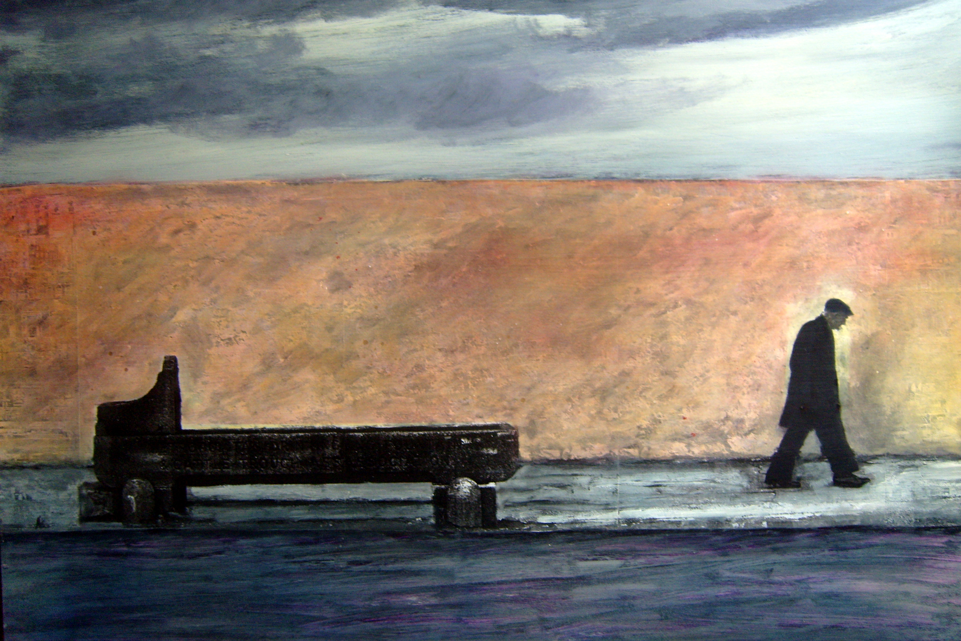
In Between Silence,
where we really exist.
STANO

Slide 2
In Between Silence, where we really exist
In Between Silence is a multi-sensory experience that unlocks the disappearing stories of our times.
Music by the ground-breaking artist, Stano, enables the story teller to weave their tale as part of an eclectic archive.
Expect to get to know real people, expect to be moved, and do not confine yourself to the limits of expectation.

Slide 3
Our mission
To create a social archive of stories of our time by collecting, recording and screening stories from diverse voices to demonstrate the similarities rather than the differences between us.
Highlighting the universality of the human experience.
Sharing the stories with a global audience, to create a greater understanding and increase communication between different communities.

Slide 4
The storytellers
We are committed to giving voice to the usually unheard by playing their stories alongside those from well known writers and artists.
Contributors will be heard on their terms, their words will not be edited. They will not be spoken about, they will speak for themselves.
The only direction to the storyteller is to relate an event or moment in their life that is significant to them.
The music subtly underpins the story as it’s being told, in an unconscious way, enabling the person to speak from deep within themselves and seems to unlock a deep emotional response.

Slide 5
The audience
The audience sit comfortably in a darkened space and hear a range of stories.
The stories are more than words, they connect with us at a deep level that we carry with us long after the experience of listening.
The audience share in the most basic of human interactions, our desire to share the stories of our lives with each other.

Slide 6
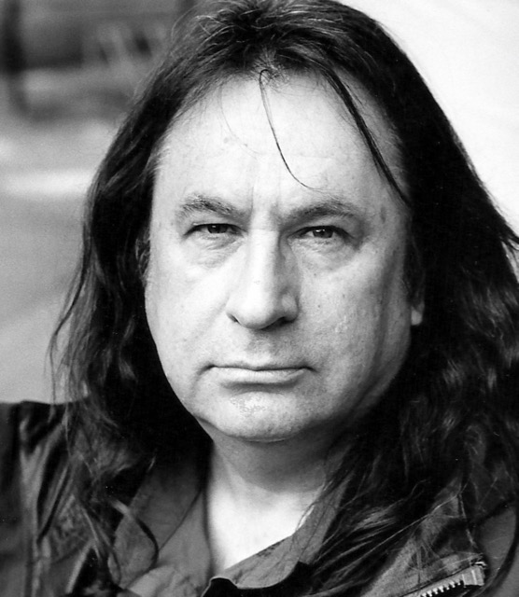
Who is Stano?
A multidisciplinary artist with 24 albums, 7 movie soundtracks, 30 live multi-media performances, and 12 art exhibitions to his credit.
With In Between Silence, Stano is creating a reservoir of the stories of our lives, of what it is / was like to be in that world.
Stano’s music subtly reinforces the sensory experience, stretching the emotional range, continuing after all the words are spent.
Stano’s original music underscores the voice of the narrator while they tell their story, creating a brand new form of story telling.

Slide 7
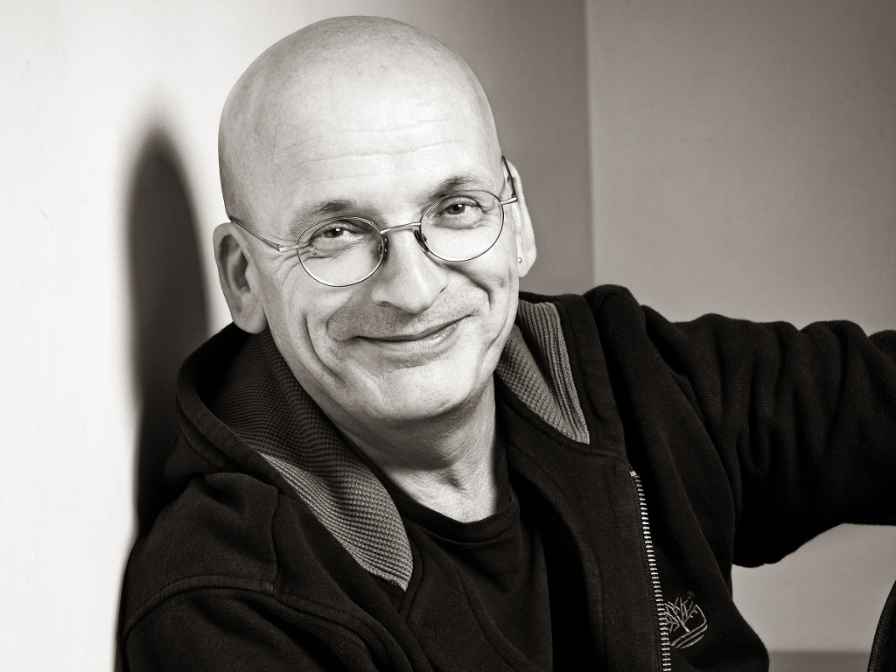
Our Story Tellers
“Working with Stano was an extraordinary, surprising experience, how he’d taken a couple of hundred spoken words and made, to my ear, something brand new, a new form of story-telling, out of them.”
- Roddy Doyle.

Slide 8
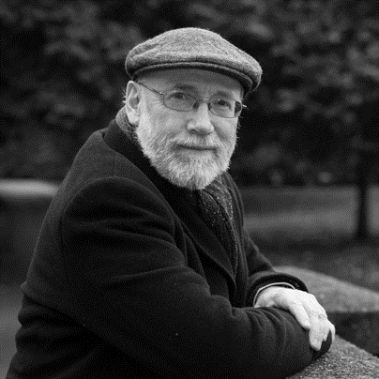
Our Story Tellers
“I listened to Brian Palm’s story and within 90 seconds of it I knew that I trusted Stano implicitly and that sense of trust is so important, Stano is creating a reservoir of the stories of our lives, of what it’s like to be in the world.”
- Dermot Bolger

Slide 9
Local & International Performances
Ireland
United States
Radio
Belfast Festival of the People
Galway International Arts Festival
Cork World Book Festival
Indie Cork Film Festival
National Museum of Ireland,
International Literature Festival
Axis Arts Centre Ballymun
St. Patricks Mental Health Hospital
First Fortnight Festival
Scandinavia House
Origin Theatre Company
Barrow Street Theatre
RTE Ireland
Midlands 103FM Ireland
WBAI New York
RTE Lyric FM
Australia
Hand in Hand Irish Aboriginal Festival Perth WA

Slide 10
What next…
Plans include capturing the stories of:
The capacity to capture and archive our stories is almost limitless.
We seek sponsorship and CSR donations to support the further development and contribution to this important national and international archive through Stano’s unique approach. A range of packages are available.
In Between Silence is now registered as a not for profit company with appropriate corporate governance in place to manage and control our activities into the future.
In Between Silence has been approved to receive donor advised grants through the Ireland Funds Boston Chapter under 501c3.
Young people experiencing mental health issues
Migrants who have experienced the Direct Provision Programme
Peacekeepers
Indigenous populations of North America and Australia
Community of Harlem
Dublin’s Docklands
People of the Islands around Ireland
African Americans
Irish travelling community
All, who have a story to tell
.

Slide 11
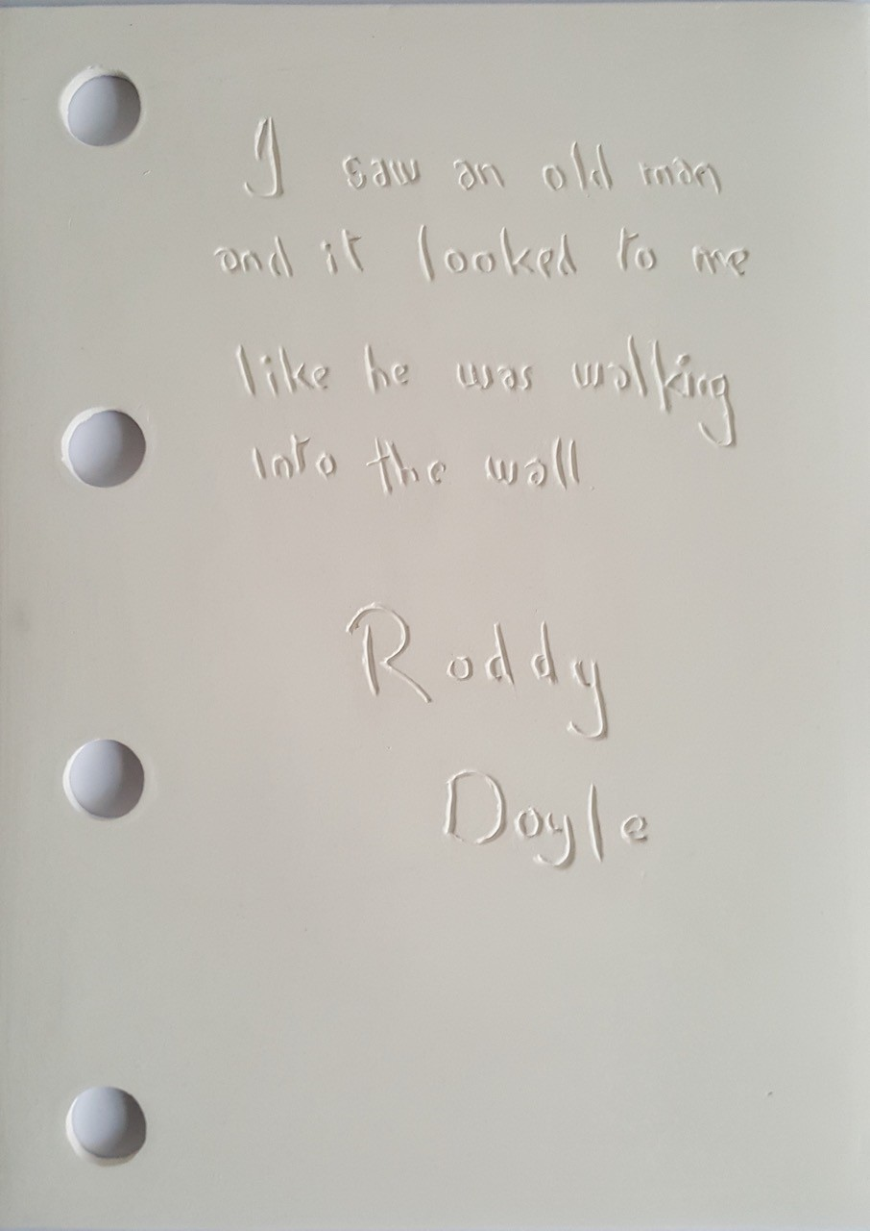
The Archive for future generations
University College Cork will curate a permanent archive within the Treasure’s collection of Boole Library.
The Porcelain Book (created by Kevin Pierce) designed to capture a fragment of the story has been purchased by UCC as a work of national importance, it will sit alongside the Great Book of Ireland.

Slide 12
Plans include capturing the stories of:
Plans include capturing the stories of:
Migrants and Refugees
Peacekeepers
Young people experiencing mental health issues
Dublin’s Docklands
Irish travelling community
People of the Islands around Ireland
Indigenous populations of North America and Australia
African Americans
All, who have a story to tell
Young people experiencing mental health issues
Migrants who have experienced the Irish Direct Provision Programme
Migrants and Refugees
Peacekeepers
Indigenous populations of North America and Australia
Community of Harlem
Dublin’s Docklands
People of the Islands around Ireland
African Americans
Irish travelling community
All, who have a story to tell
.

Slide 13
Experience it for yourselves
We are happy to arrange a screening for you.
For further information contact Denise Dunphy at denisedunphy@gmail.com
https://inbetweensilence.ie https://stanoartist.ie

